Slide 1
Simulating the Auditory Processing Pipeline of a Cochlear Implant
Mezisashe Ojuba
5th June 2024.
Notes:
Plan:
Explain what cochlear implant is (with references) and the sides
Explain how it works with graph like https://www.researchgate.net/figure/Overview-of-the-Audio-Processing-Pipeline-The-trainable-model-is-depicted-by-the-yellow_fig1_370949452
Explain original sound and where you got it from, Spectrogram
Show graph with all three images. Image should show bandpass frequency, etc. Play sound before and after (images should be 6 channels, sound should include 20 channels, etc). Put reference of where you got the frequencies for bandpassing from.
Noise - play sound before and after

Slide 2
What is a cochlear implant?
An electronic device to provide hearing sensation to Deaf/Hard-of-Hearing people.
Normal Hearing
Outer, middle, inner ear
Hair cells in the Cochlear
Notes:
Hearing is lost when the hair cells in the cochlear are so damaged they cannot stimulate the spiral ganglion (auditory nerve cells).
Exterior parts of the cochlear are sensitive to higher frequencies of sound. Interior parts to lower frequencies of sound.

Slide 3
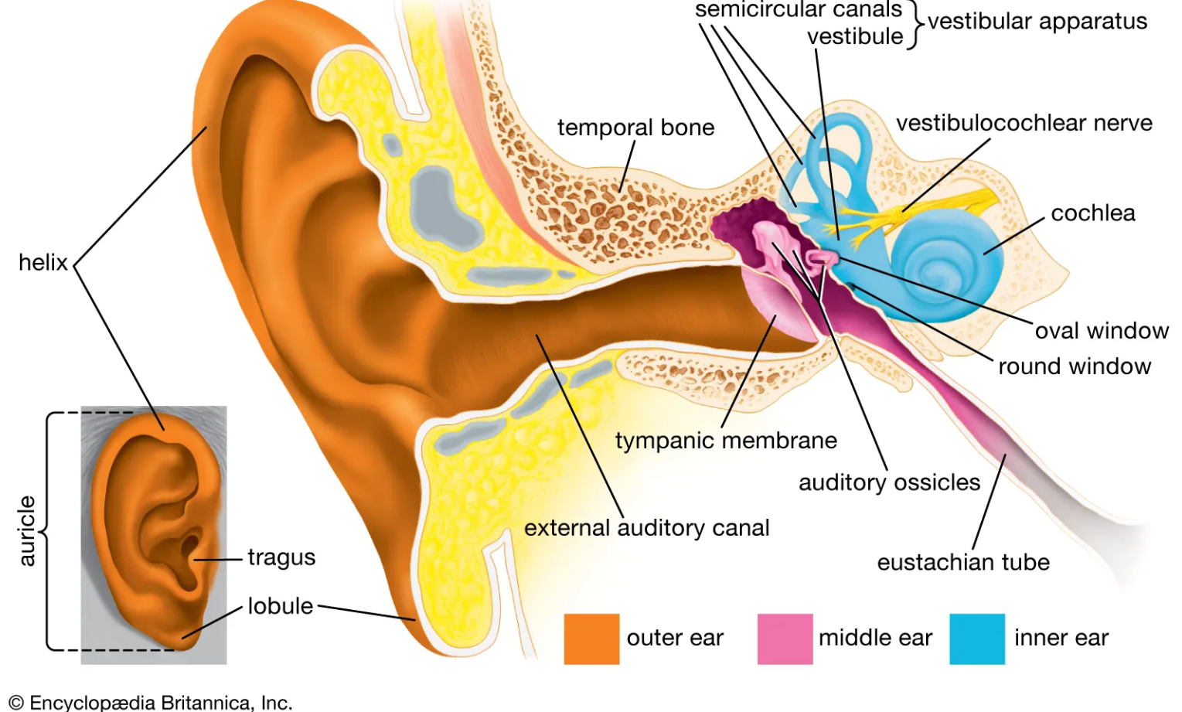
Structure of Human Ear. Source: Britannica.

Slide 4
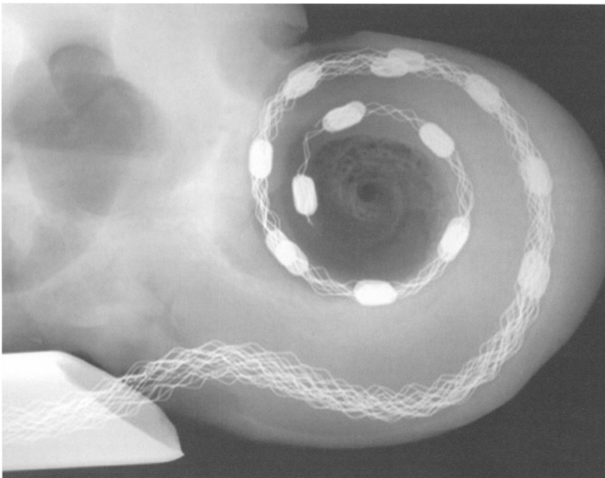
Image of Cochlear. Source: Dorman and Wilson, 2004.

Slide 5
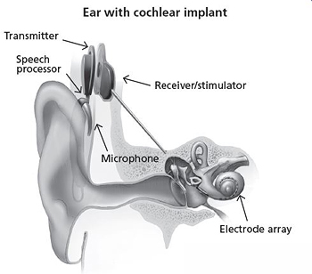
What is a cochlear implant?
Parts of a cochlear implant
A microphone
speech processor
transmitter
Receiver/stimulator
electrodes
Ear with cochlear implant. Source: NIH/NIDCD
Notes:
Figure 6. Cochlear implants have five main components, only two of which are inside the body. A microphone above the ear senses sound waves, which are directed to a tiny computer tucked behind the ear. The computer is programmed to transform the input into specifications for stimuli to be delivered to the implanted electrodes. A disk-shaped transmitter uses high-bandwidth radio waves to convey these instructions to a thin receiver just under the skin. The receiver converts the instructions into electrical stimuli and sends them to the correct electrode in the cochlea, which in turn excites neurons in the auditory nerve.

Slide 6
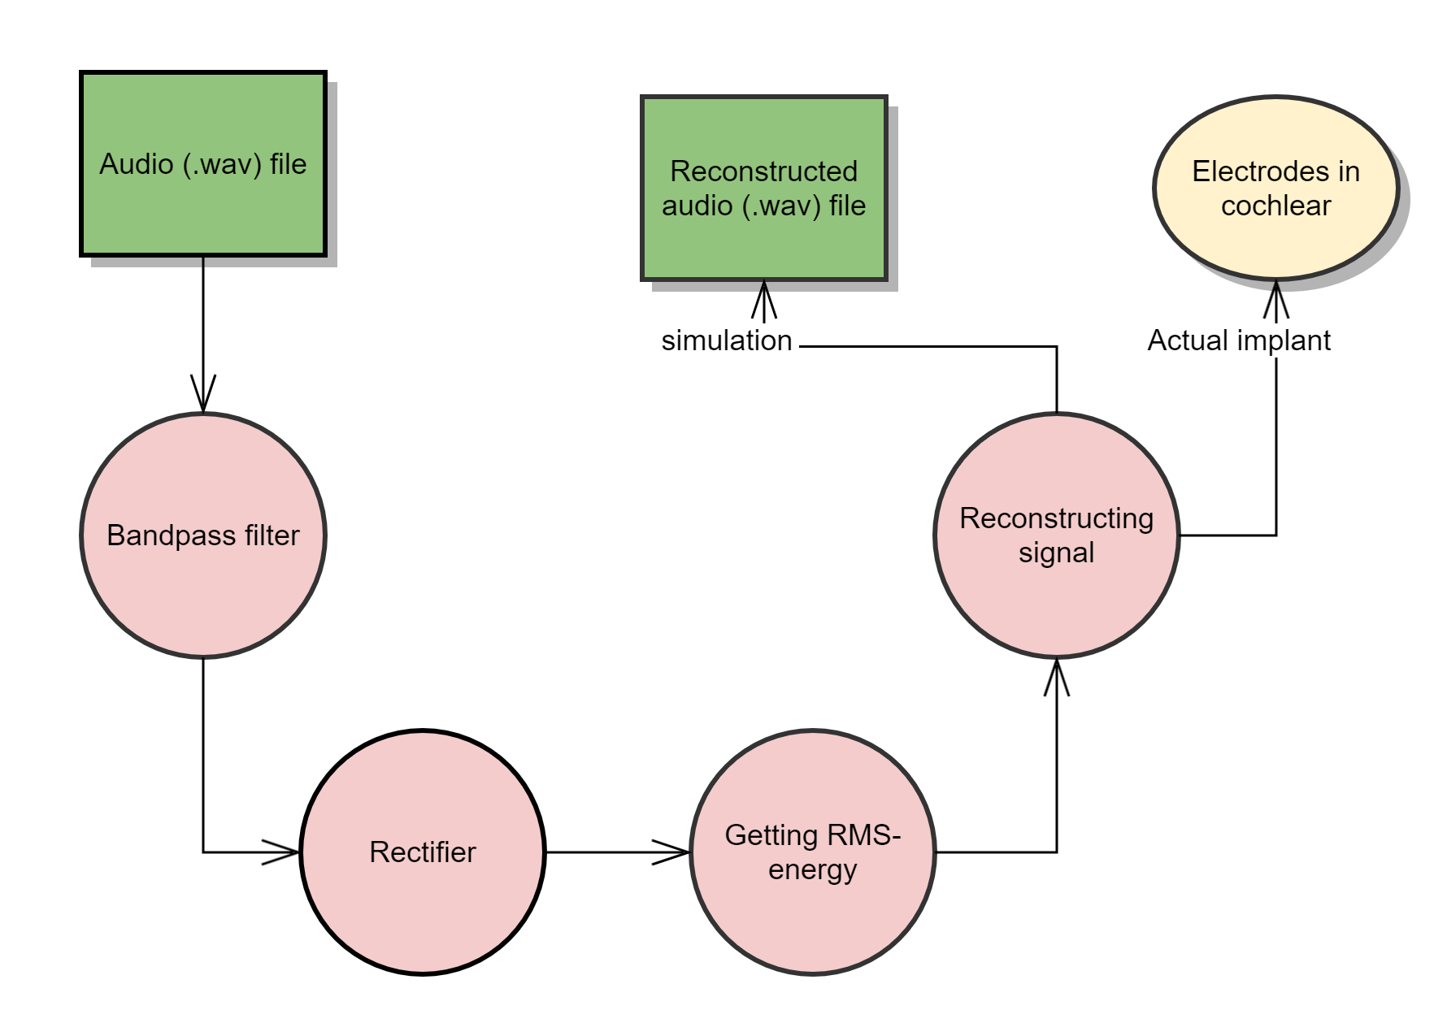
Auditory Pipeline for Cochlear Implant (simplified)
Notes:
Why simulate the auditory processing pipeline for cochlear implant? To enable testing without actual Deaf people with cochlear implants. Conduct experiments with simulations, then test the promising results on actual Deaf people with cochlear implants.
Talk a bit about sound:
Formants, frequencies
Define Bandpass, rectifies, significance of rms energy, reconstructing signal
So to simulate the auditory processing pipeline for a cochlear implant, these were the steps used:

Slide 7
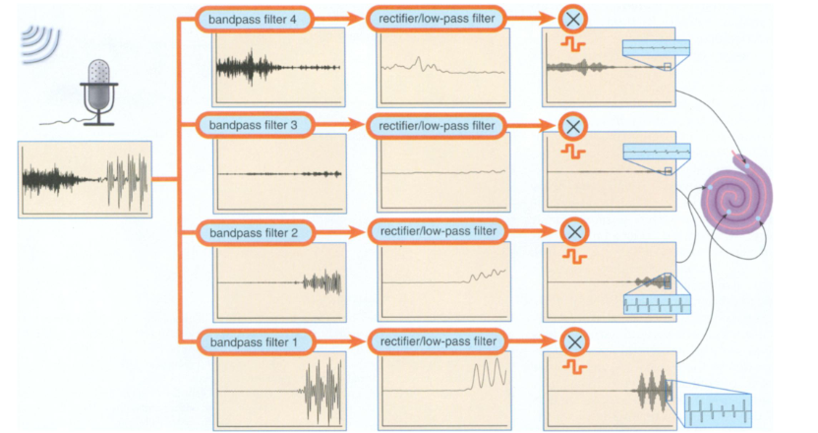
Auditory Processing Pipeline of Cochlear Implant. Source: Dorman and Wilson, 2004.
Notes:
Reconstructed signal is not the same as input signal. It conveys useful information, but some of the complexities of real world sound are missing.
Can see this through the difference between the graph of the bandpassed signals and the electrode-wave signals - bandpassed is more jaggedy and electrode wave is more uniform.
However, speech is still discernible.
Dorman 2004 points out - due to the imprecision of the information transmitted by cochlear implants, people with cochlear implants do not report experiencing music the same way they achieve high word recognition.

Slide 8

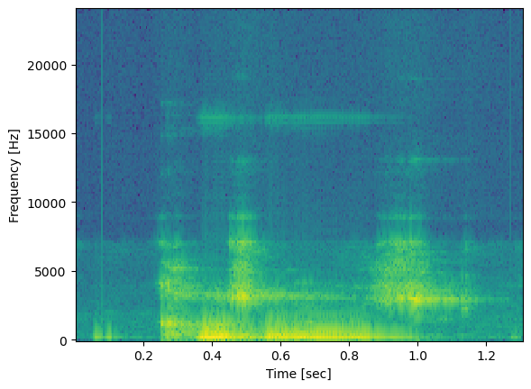
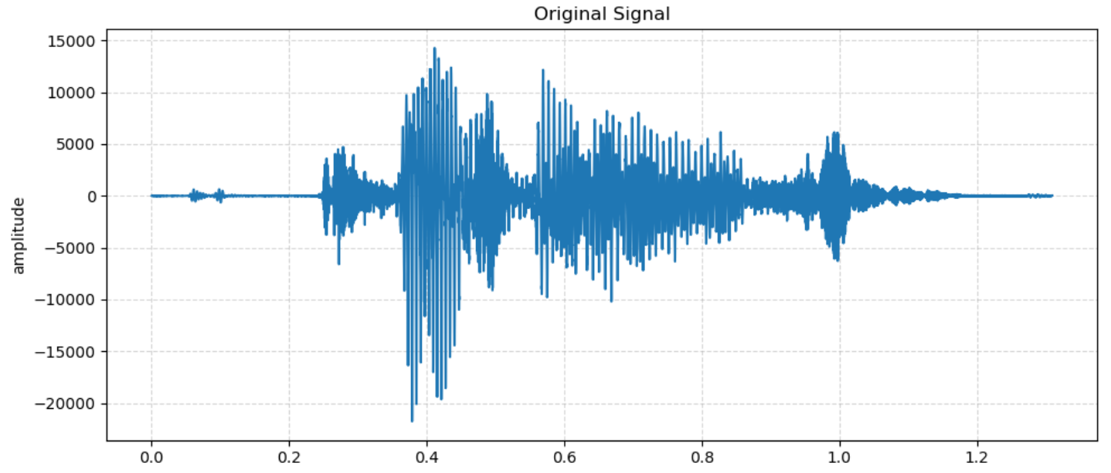
Input Sound Used: “Cosmos”
Spectrogram of Input Sound.

Slide 9
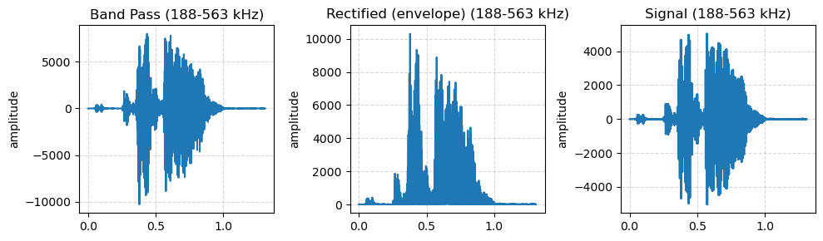
Reconstructing “cosmos”
A*sin(2 *pi* cF * t/fs)
Notes:
I used frequency bands in svirsky et al 2015 for bandpassing.
Show lowest frequency band for legibility.
Explain the process gone through

Slide 10
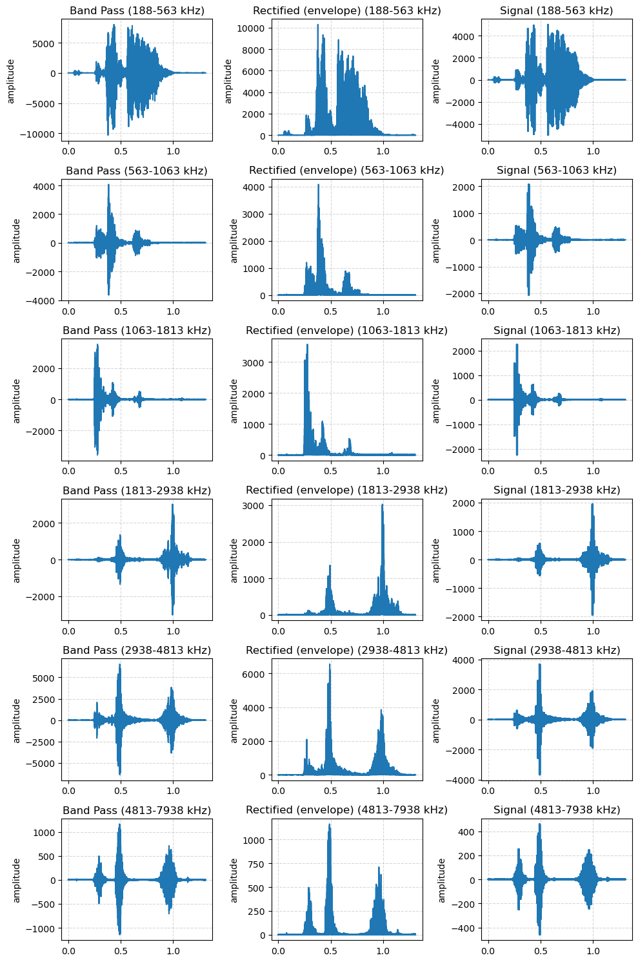
Output (6 channels)
Input
Output (22 channels)
Jupyter Notebook
Notes:
As expected, the output using just 22 bands is much clearer and intelligible than the one with 6 bands.

Slide 11
Noise

Slide 12
References
Cochlear Implants. (2024, May 6). NIDCD. https://www.nidcd.nih.gov/health/cochlear-implants
Dorman, M. F., & Wilson, B. S. (2004). The Design and Function of Cochlear Implants: Fusing medicine, neural science and engineering, these devices transform human speech into an electrical code that deafened ears can understand. American Scientist, 92(5), 436–445. http://www.jstor.org/stable/27858452
File:LL-Q1860 (eng)-Vealhurl-cosmos2.wav - Wikimedia Commons. (2020, October 17). https://commons.wikimedia.org/wiki/File:LL-Q1860_(eng)-Vealhurl-cosmos2.wav
Hawkins, J. E. (2024, March 26). human ear. Encyclopedia Britannica. https://www.britannica.com/science/ear
Svirsky, M. A., Fitzgerald, M. B., Sagi, E., & Glassman, E. K. (2015). Bilateral cochlear implants with large asymmetries in electrode insertion depth: implications for the study of auditory plasticity. Acta oto-laryngologica, 135(4), 354–363. https://doi.org/10.3109/00016489.2014.1002052
Jupyter Notebook

